Slide 1
FRB Update #26
William Huang
(07/03/2021)

Slide 2
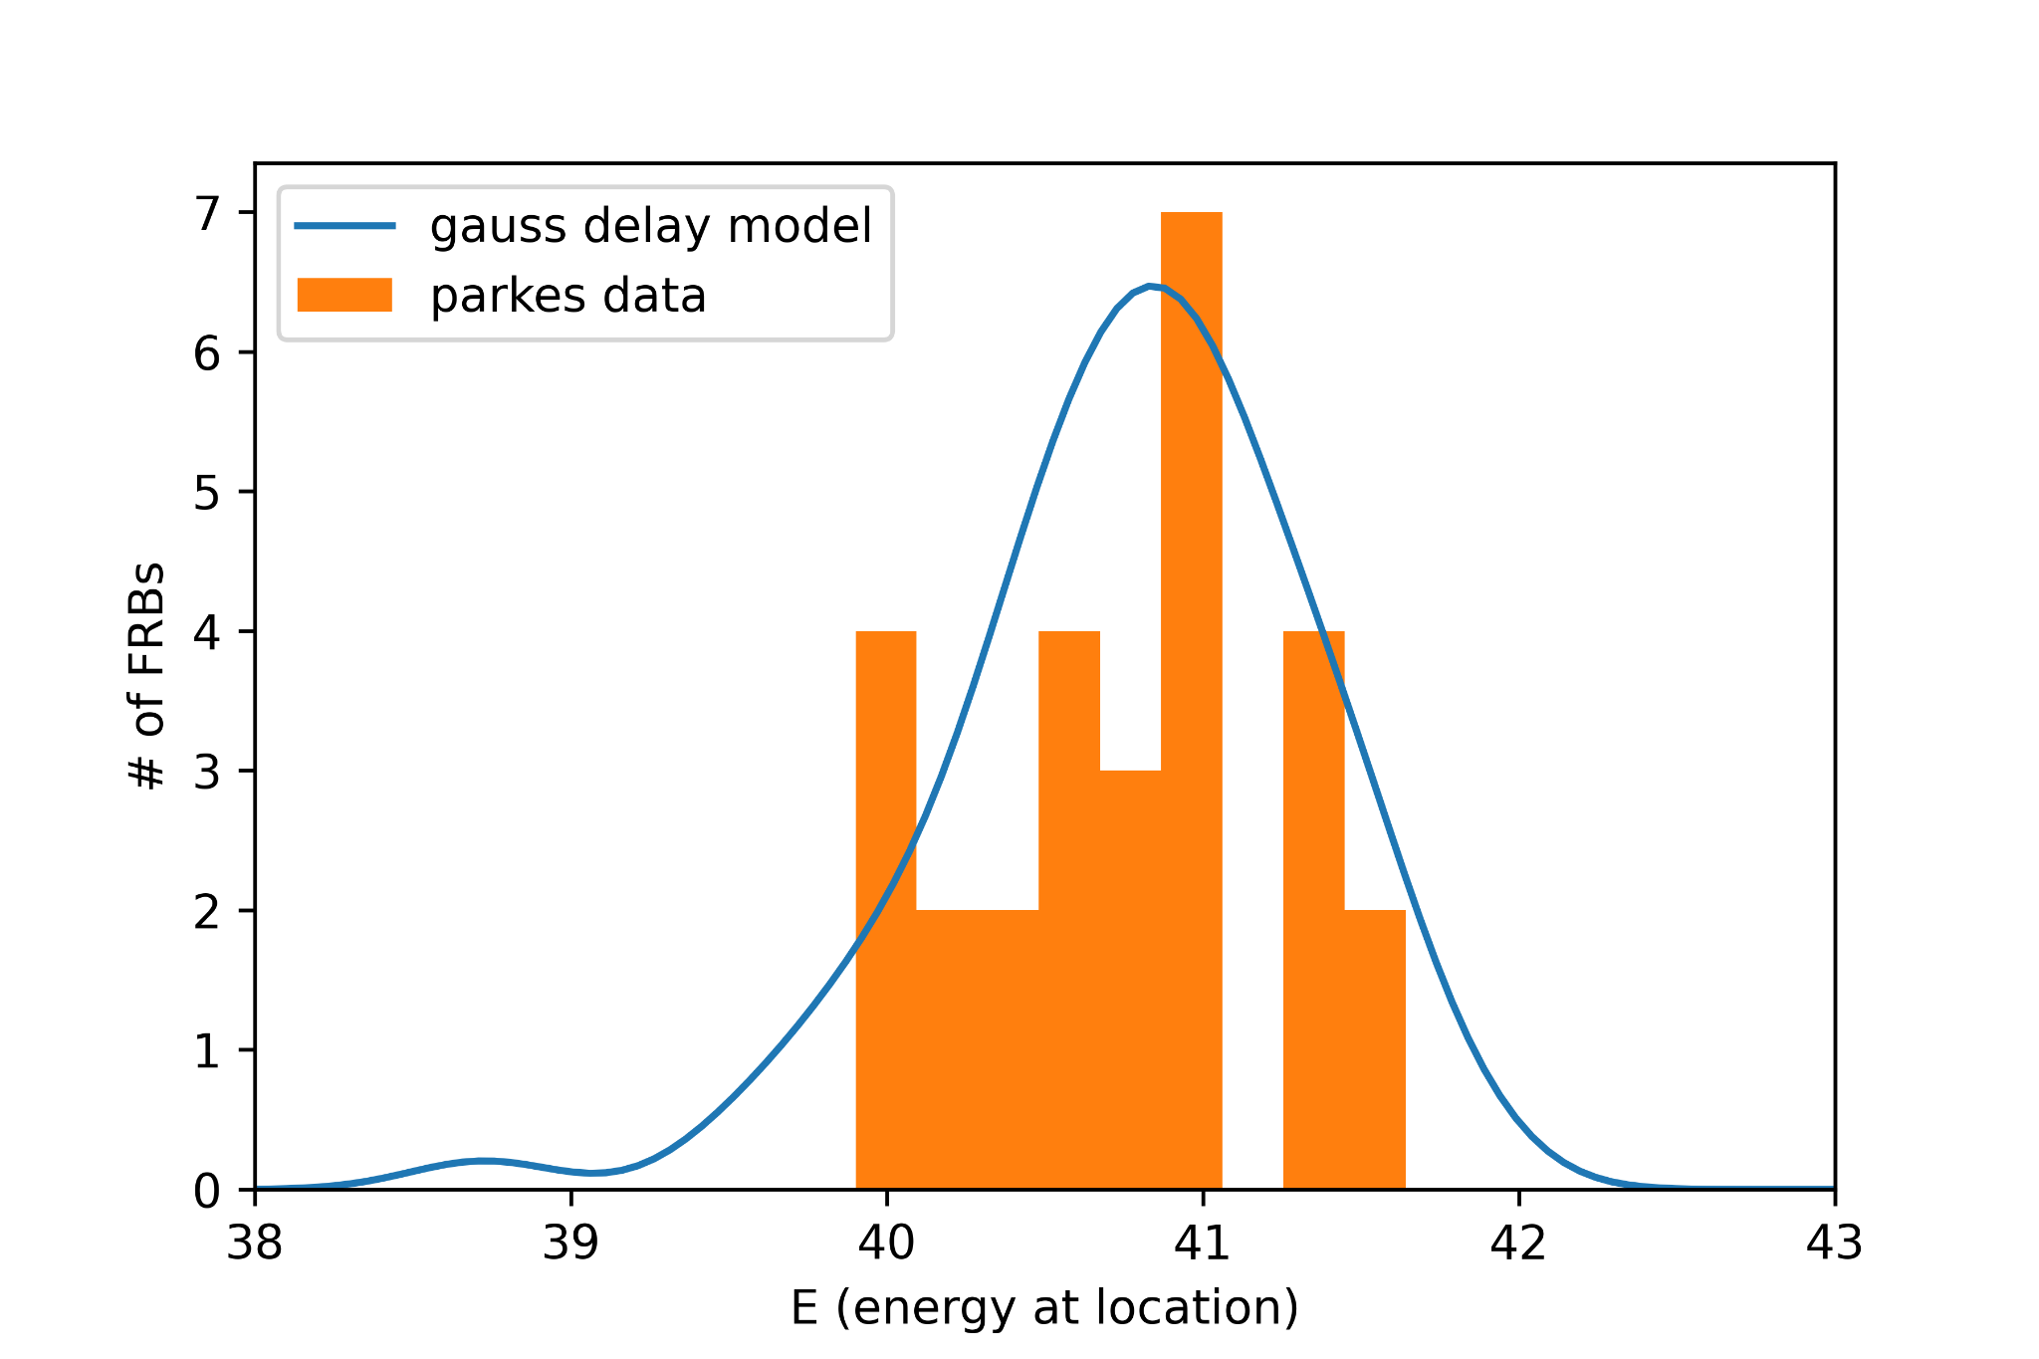
Energy Distribution Plot
Predicted energy distribution, based on Zhang et al. 2020’s gaussian delay model, versus Parkes data.
x-axis is in erg.
See the right center plot in Figure 4 of Zhang et al. 2020.

Slide 3
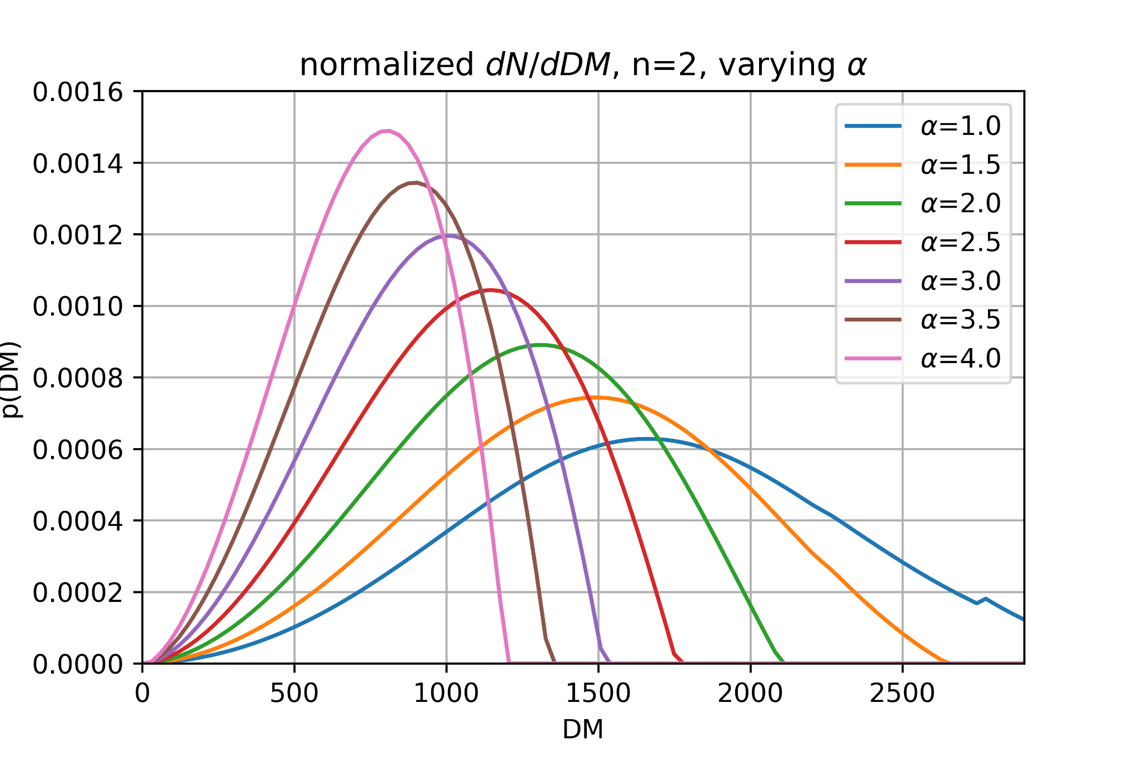
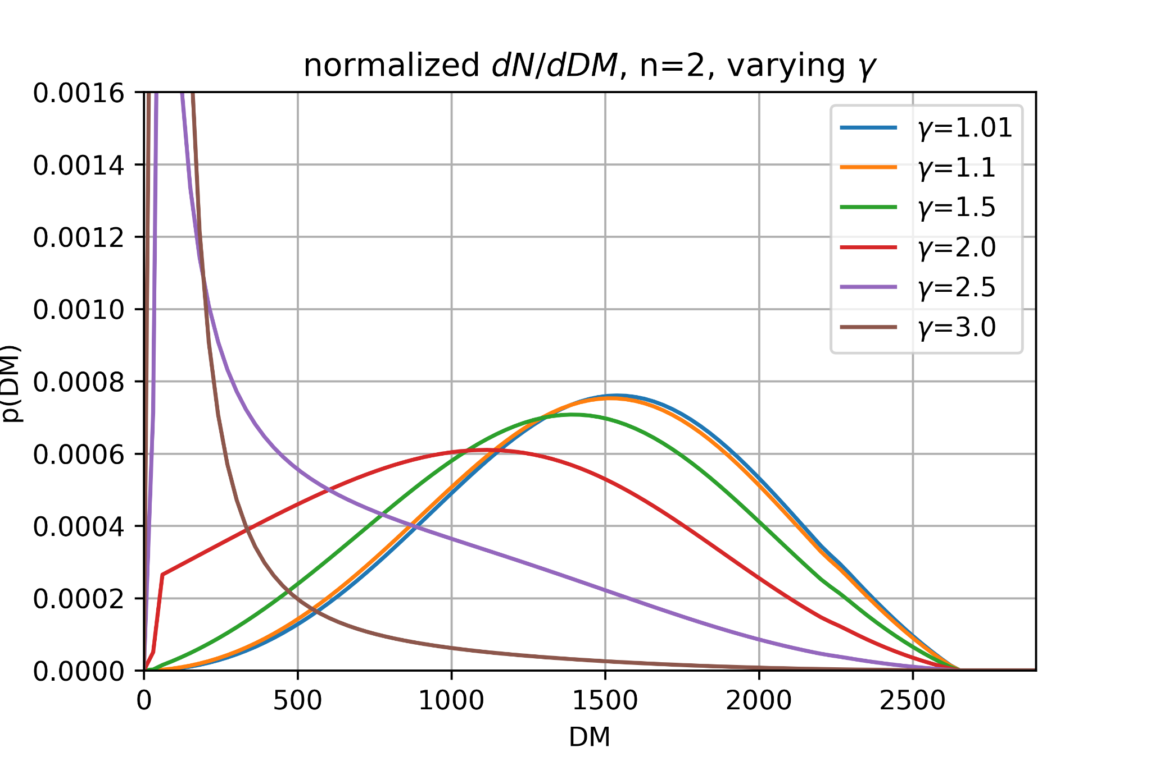
FRB distribution with DM, according to Arcus et al. 2020
Using E_{max} = 7.4 x 10²⁵ J Hz⁻¹, the Arcus model I implemented was able to produce similar graphs to that of the paper. This corresponds to the bottom two graphs of Figure 4.

Slide 4
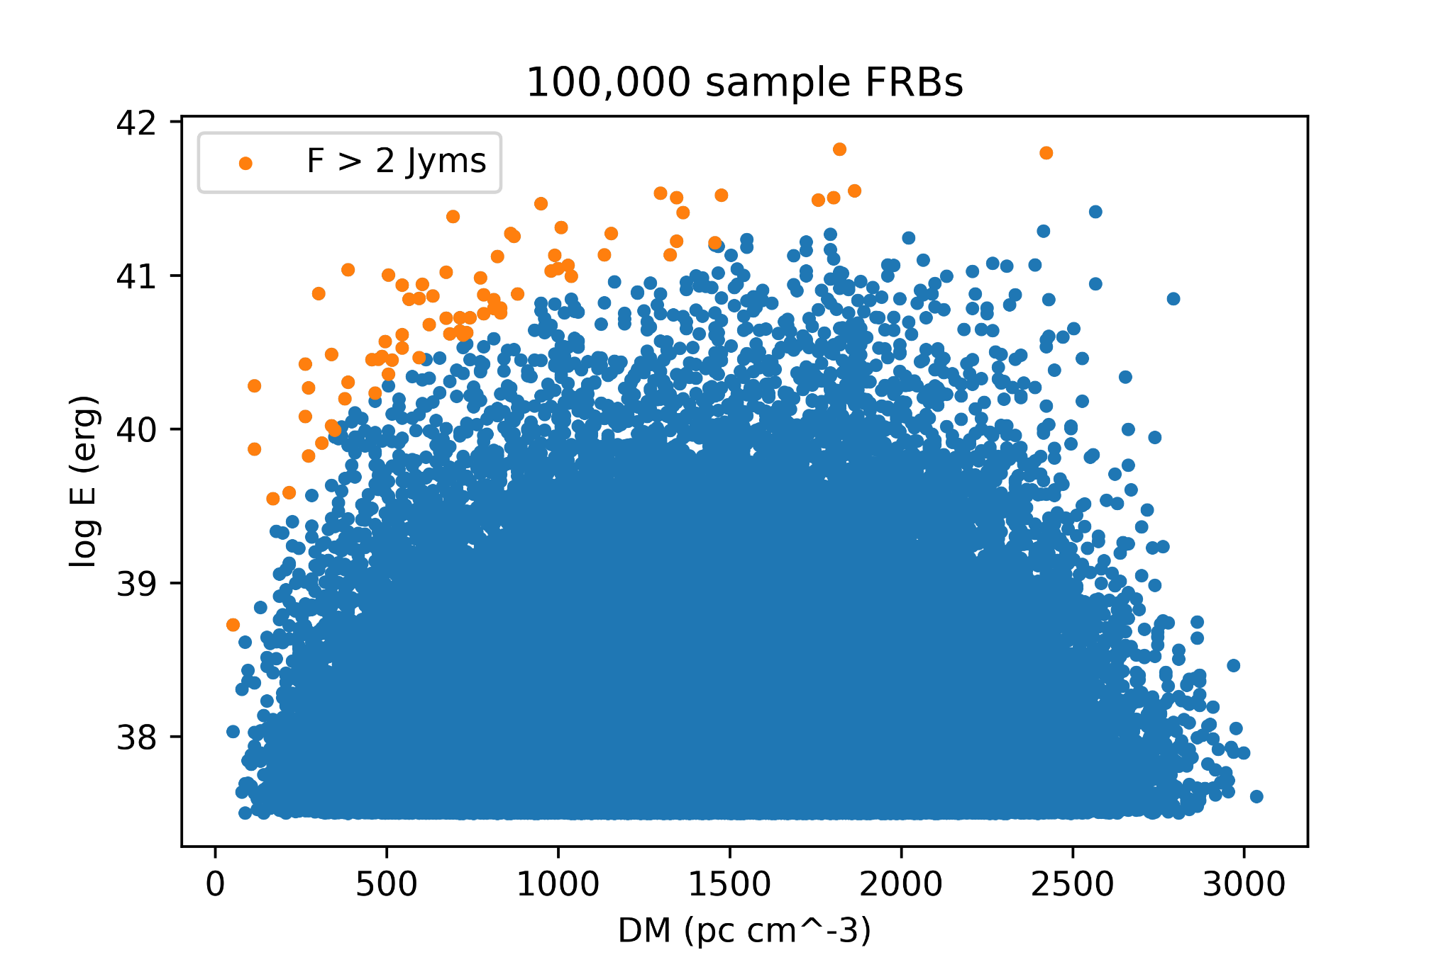
Fluence Cutoff
For both paper’s models, the fluence cutoff greatly changes the population of FRBs observed from the intrinsic population of FRBs. However, the fluence limit is a well defined line, as before.

